Slide 1
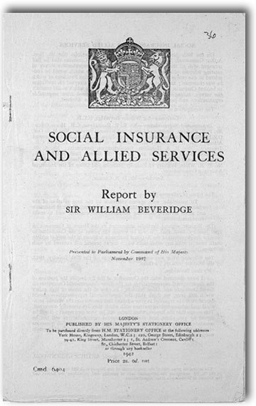
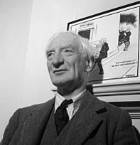
BEVERIDGE REPORT -1942 social insurance and allied services
By:
Dr. Imran A. Sajid
DSW| UOP
imranahmad131@uop.edu.pk
Based on Walter Friednlander’s, Introduction to Social Work and Social Welfare

Slide 2
THE BEVERIDGE REPORT
During the dramatic hours of the Second World War, in 1941, when bombs were continuously falling outside the British parliament , the West Minster, the Britons started reforming their entire social welfare programmes..

Slide 3
In 1940, during the Second World War, the Labour Party entered into a coalition with the Conservative Party.
On 10 June 1941 Arthur Greenwood, the Labour MP, announced the creation of an inter-departmental committee which would carry out a survey of Britain's social insurance and allied services:
Notes:
and Minister without Portfolio
.
“To undertake, with special reference to the inter-relation of the schemes, a survey of the existing national schemes of social insurance and allied services, including workmen's compensation, and to make recommendations.”

Slide 4
The parliament appointed a high level committee under the Chairmanship of William Beveridge to survey the structure and efficacy of the entire social services and to make recommendations for necessary reforms

Slide 5
William Henry Beveridge
William Henry Beveridge, 1st Baron Beveridge, (born March 5, 1879, Rangpur, India—died March 16, 1963, Oxford, Oxfordshire, England),
Economist
interested in the causes and cures of unemployment since 1903.
directed the London School of Economics and Political Science from 1919 until 1937
knighted in 1919 and was created a baron in 1946.
He contributed many works to economics including
Unemployment: A Problem of Industry (1909),
Full Employment in a Free Society(1944),
Insurance for All (1924),
British Food Control (1928),
Planning Under Socialism (1936),
Pillars of Security (1948),
Power and Influence (1953), and
A Defence of Free Learning (1959).

Slide 6
British Nobility is divided into Upper and Lower Nobility
Upper Nobility
duke,
Marquess,
Earl,
Viscount
Baron
Lower Nobility
Knight
Baronet
Esquire

Slide 7
The Beveridge Committee included representatives of all organizations of
public assistance,
social insurance,
pensions,
health,
economic affairs,
labour affairs,
treasury,
customs and excise, and
friendly societies.
The committee heard hundreds of discussions with citizens groups, ranging from
chamber of commerce ,
manufacturers associations,
commercial insurance companies
labour unions,
consumers cooperatives etc.

Slide 8
Purpose of the Report
William Beveridge report attempted to find a way to gain “Freedom From wants”.
Assumption
The basic fact which was to be addressed was that
“personal and economic sufferings were mainly caused by disruption or loss of income in the modern industrial societies.”
Five (05) Giants
The committee found out that five ‘giants’ caused human sufferings , namely,
Wants
Ignorance,
Squalor, and
Disease,
Idleness.

Slide 9
The Beveridge report devised a policy of social security in which social insurance is one measure.
The main goal of social security was
to guarantee a basic level of income for every citizen with his own efforts and
to initiate the incentives of securing for self and the family.

Slide 10
This social security consisted of five programmes, namely
a unified and comprehensive system of social insurance.
Public assistance programme to aid those people who were not covered sufficiently by social insurance benefits.
Children allowances, providing a weekly allowance for each child after the first ( now-a-days the first one gets more allowance than the rest)
a comprehensive free health and rehabilitation service for the entire population and
the maintenance of full employment through public works in order to prevent mass unemployment in economic crisis.
This proposal was meant to protect the entire population and not only the laboring class.
It was a unified system and was administered by one ministry, the ministry of “pensions and national Insurance” coordinating the efforts of many organizations which were uncoordinated in the past.

Slide 11
This social security consisted of five programmes, namely
01. a unified and comprehensive system of social insurance.
02. Public assistance programme to aid those people who were not covered sufficiently by social insurance benefits.
03. Children allowances, providing a weekly allowance for each child after the first ( now-a-days the first one gets more allowance than the rest)
04. a comprehensive free health and rehabilitation service for the entire population and
05. the maintenance of full employment through public works in order to prevent mass unemployment in economic crisis.
This proposal was meant to protect the entire population and not only the laboring class.
It was a unified system and was administered by one ministry, the ministry of “pensions and national Insurance” coordinating the efforts of many organizations which were uncoordinated in the past.

Slide 12
Six PRINCIPLES were suggested for the procedure, namely,
A Unified administration
Comprehensive coverage
flat rate of contributions
flat rate of benefits
adequacy of all benefits to meet the basic needs of the recipients and
classification of the population.
The report had suggested six groups of population , namely

Slide 13
The report was implemented in the shape of three acts of parliament namely
National Insurance Act 1946,
All persons of working age had to pay a weekly contribution and in return were entitled to a wide range of benefits, including Guardian’s (or Orphans) Allowances, Death Grants, Unemployment Benefit, Widow’s Benefits, Sickness Benefit, and Retirement Pension.
National Health Service Act 1946
It provided for free mental and physical health services for everyone
National Assistance Act 1948
It formally abolished the Poor Law system that had existed since the reign of Elizabeth I and established a social safety net for those who did not pay National insurance contributions (such as the homeless, the physically handicapped, and unmarried mothers) and were therefore left uncovered by the National Insurance Act 1946

Slide 14
CLASSIFICATION OF POPULATION
1. employees
2. employers and self-employed persons
3. house wives
4. adults who were not gainfully employed e.g. crippled, insane and invalid.
5. retired persons above working age.
6. Children below working age.

Slide 15
The report was implemented in the shape of three acts of parliament namely
National Insurance Act 1946
All persons of working age had to pay a weekly contribution and in return were entitled to a wide range of benefits, including Guardian’s (or Orphans) Allowances, Death Grants, Unemployment Benefit, Widow’s Benefits, Sickness Benefit, and Retirement Pension.
National Assistance Act 1948
It formally abolished the Poor Law system that had existed since the reign of Elizabeth I and established a social safety net for those who did not pay National insurance contributions (such as the homeless, the physically handicapped, and unmarried mothers) and were therefore left uncovered by the National Insurance Act 1946
National Health Service Act 1946
It provided for free mental and physical health services for everyone

Slide 16
The National Insurance Act of 1946, reduced the no. of classes to three, namely,
Employed persons gainfully occupied in GB under a contract of service
Self-employed people gainfully occupied but under no control of an employer ; and
Non-employed person.

Slide 17
CONCLUSION
Beveridge said that the underlying social philosophy of his plan was to secure Britons against “wants” and other social evils, and that social security should be rendered to preserve the personal freedom and responsibility of the individual for his family.
Beveridge report became the foundation of the modern social welfare in the UK and a model for the world.
The Post WWII reforms lead to the creation of Welfare State and the UK declared itself the 1st Welfare State in the World on 10th December 1948

